Slide 1
Preliminary
شبكات الحاسوب اللاسلكيه
هي مجموعة من الوحدات (أجهزة الحاسوب) المرتبطة بقنوات لاسلكية بهدف تبادل المعلومات والاشتراك في المصادر بينها.

Slide 2
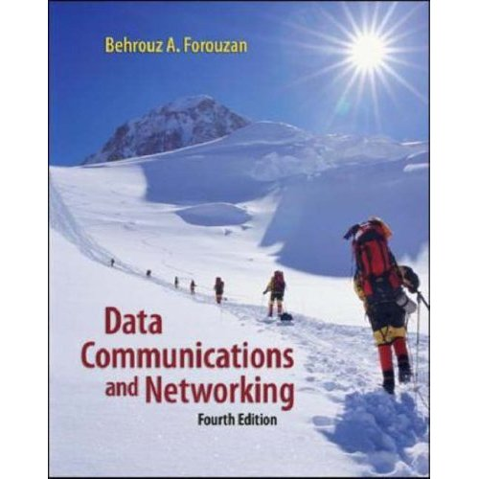
Text book
Data Communications and Networking, 4th edt.
Author: Behrouz A. Forouzan

Slide 3
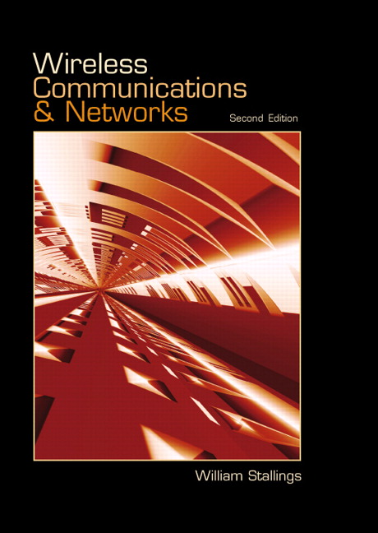
Reference book
Textbook: William Stallings, Wireless Communications and Networks, 2nd Edt. Prentice Hall, 2002.
The Web site: http://williamstallings.com/Wireless1e.html

Slide 4
Topics of this course (2/3)
Data Link Layer
  Error Detection and Correction
  Data Link Control
  Multiple Access
Wireless Part
  Introduction of wireless communications
  Transmission fundamentals
  Communication network
  Protocols and the TCP/IP suite

Slide 5
Topics of this course (3/3)
Wireless Communication Technology
  Antennas and propagation
  Signal encoding techniques
  Spread spectrum
  Coding and error control
  Satellite communications

Slide 6
Wireless Comes of Age
Guglielmo Marconi invented the wireless telegraph in 1896
  Communication by encoding alphanumeric characters in analog signal
  Sent telegraphic signals across the Atlantic Ocean
Communications satellites launched in 1960s
Advances in wireless technology
  Radio, television, mobile telephone, communication satellites
More recently
  Satellite communications, wireless networking, cellular technology

Slide 7
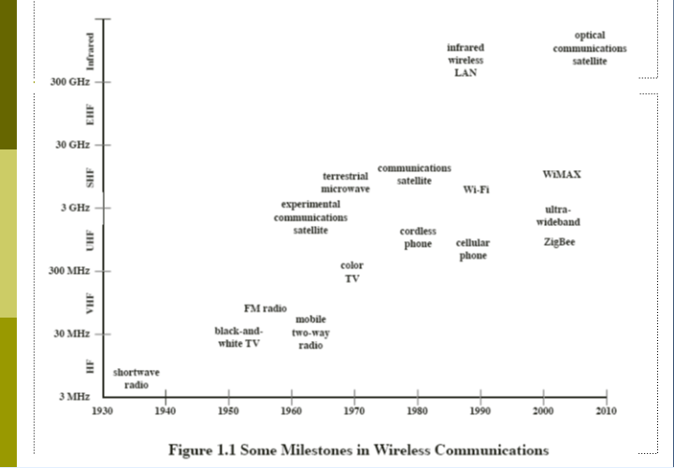

Slide 8
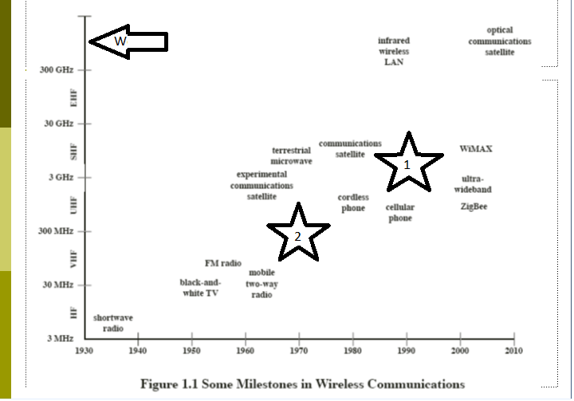


Slide 9
Broadband Wireless Technology
Higher data rates obtainable with broadband wireless technology
  Graphics, video, audio
Shares same advantages of all wireless services: convenience and reduced cost
  Service can be deployed faster than fixed service
  No cost of cable plant
  Service is mobile, deployed almost anywhere

Slide 10
Limitations and Difficulties of Wireless Technologies
Wireless is convenient and less expensive
Limitations and political and technical difficulties inhibit wireless technologies
Lack of an industry-wide standard
Device limitations
  E.g., small LCD on a mobile telephone can only displaying a few lines of text
  E.g., browsers of most mobile wireless devices use wireless markup language (WML) instead of HTML

Slide 11
Part One: Background
Provides preview and context for rest of book
Covers basic topics
  Data Communications
  TCP/IP

Slide 12
Chapter 2: Transmission Fundamentals
Basic overview of transmission topics
Data communications concepts
  Includes techniques of analog and digital data transmission
Channel capacity
Transmission media
Multiplexing

Slide 13
Chapter 3: Communication Networks
Comparison of basic communication network technologies
  Circuit switching
  Packet switching
  Frame relay
  ATM

Slide 14
Part Two: Wireless Communication Technology
Underlying technology of wireless transmission
Encoding of analog and digital data for wireless transmission

Slide 15
Chapter 5: Antennas and Propagation
Principles of radio and microwave
  Antenna performance
  Wireless transmission modes
  Fading

Slide 16
Chapter 6: Signal Encoding Techniques
Wireless transmission
  Analog and digital data
  Analog and digital signals

Slide 17
Chapter 7: Spread Spectrum
Frequency hopping
Direct sequence spread spectrum
Code division multiple access (CDMA)

Slide 18
Chapter 8: Coding and Error Control
Forward error correction (FEC)
Using redundancy for error detection
Automatic repeat request (ARQ) techniques

Slide 19
Part Three: Wireless Networking
Examines major types of networks
  Satellite-based networks
  Cellular networks
  Cordless systems
  Fixed wireless access schemes
Use of mobile IP and Wireless Access Protocol (WAP) to provide Internet and Web access

Slide 20
Chapter 9: Satellite Communications
Geostationary satellites (GEOS)
Low-earth orbiting satellites (LEOS)
Medium-earth orbiting satellites (MEOS)
Capacity allocation

Slide 21
Chapter 10: Cellular Wireless Networks
Cellular wireless network design issues
First generation analog (traditional
mobile telephony service)
Second generation digital cellular networks
  Time-division multiple access (TDMA)
  Code-division multiple access (CDMA)
Third generation networks

Slide 22
Part Four: Wireless Local Area Networks
Examines underlying wireless LAN technology
Examines standardized approaches to local wireless networking

Slide 23
Chapter 13: Wireless LAN Technology
Overview of LANs and wireless LAN technology and applications
Transmission techniques of wireless LANs
  Spread spectrum
  Narrowband microwave
  Infrared

Slide 24
Chapter 14: IEEE 802.11 Wireless LAN Standard
Wireless LAN standards defined by IEEE 802.11 committee

